Slide 1

CS 470 Project Two Conference Presentation: Cloud Development
David Varella
December 2024

Slide 2
Overview
My name is David Varella and I am a developer for the startup company, QnA.
The purpose of this presentation is to articulate the intricacies of cloud development to both technical and nontechnical audiences and to teach other developers the importance of using an AWS serverless solution.

Slide 3
Containerization
Single-container: The entire app is packaged into one container.
Multi-container: The app is packaged in multiple containers (front-end, back-end). Our approach created two containers; one to host an Angular front-end, and the other for a Node.js back-end REST API.
Containerization tools:
Docker – Used in local testing
Docker Compose – Uses YAML files to define services, networks, and storage volumes.
Command Line Interface(CLI) such as PowerShell

Slide 4
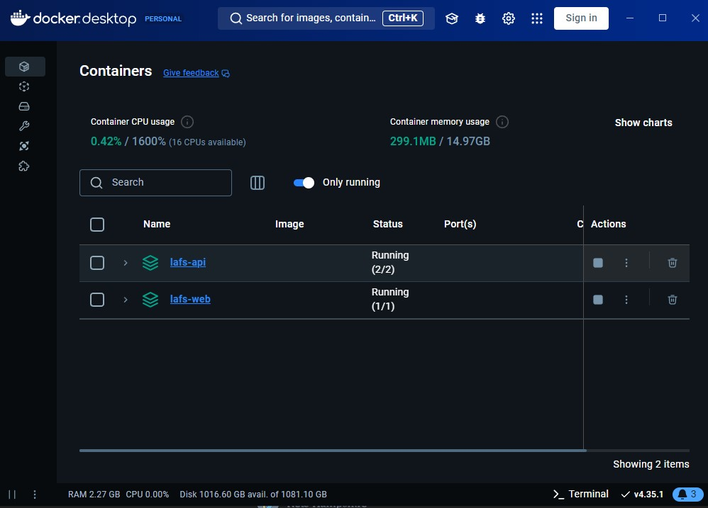
Orchestration
What is the value of using Docker Compose?
Using a single YAML file, developers can define and manage multi-container apps, specifying services, networks and volumes. Distributing a YAML is simple and ensures consistent behavior on developer’s machines, staging, or in production. Using simple commands such as “docker-compose up”, a developer can start, stop, or manage all containers.

Slide 5
The Serverless Cloud
S3 Storage | Local Storage
Scales automatically | Limited space, requires additional storage or deletion of data
Data available anywhere with internet. Can also retrieve data in the rare case of an S3 server crashing | Data only available locally. Also, server crashing may cause permanent data loss
Contains built in encryption, access controls such as IAM roles and policies | Local security – firewall, password protection, 2FA
Performance is based on internet speed connection | Quicker access, often based on hardware
Pay-as-you-go pricing | Pricing based on costs to purchase, cool, and power the server
Serverless
Serverless computing refers to a cloud computing model in which the server layer is separated from the application, so that a cloud provider manages it.
Advantages:
Faster Development: Developers no longer need to worry about managing and configuring a server; they can solely focus on the application requirements.
Cost-Efficient: Serverless models are only charged when resources are used (pay-per-use), rather than a set capacity that may not be used. This model also eliminates costs of powering physical server storage.
Amazon Simple Storage Service (S3) is a cloud-based object storage service that offers scalability, data availability, security, and performance.

Slide 6
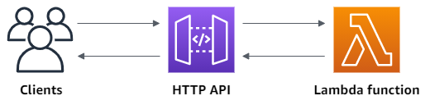
The Serverless Cloud
API & Lambda
A serverless API has advantages, such as:
Caching - A reduced number of calls to an endpoint can improve latency.
Cost – Pay only for usage.
Quick Iterations – Quick updates with backward compatibility.
Lambda API Logic:
API Gateway directs HTTP requests (GET, POST, DELETE) to Lambda functions.
IAM policies ensure secure access
Lambda functions execute requests and return responses
What scripts are produced in order to make this happen?
Lambda function code is necessary, and a YAML config file
Summarize the steps needed to integrate the frontend with the backend.
Deploy backend (AWS Lambda & API Gateway). Enable CORS to allow access
Use frontend tools (Angular) to call backend endpoints
Test using applications (Postman, Docker, etc.) and/or integration testing with actual API calls

Slide 7
The Serverless Cloud
Database
What queries did you perform?
Using API Gateway, we performed many queries; GET, POST, PUT, and DELETE were the methods we used, and they were used in querying for “questions” and “answers” using functions such as “FindOneQuestion”, “TableScan”, etc.
What scripts are produced in order to make this happen?
Lambda Function code: used to interact with database and handle HTTP requests
YAML file: used to define the config for the AWS-based services
IAM Roles/Policies: These can give access permissions for Lambda functions.
JSON: Lambda functions using test events depend on JSON with specific inputs, parameters, etc.
MongoDB | DynamoDB
JSON Based | Key-Value store with JSON support
Up to 16mb doc size | Up to 400kb record size
Regular JSON data and BSON (int, long, date, etc.) | Limited – Number, string, binary only

Slide 8
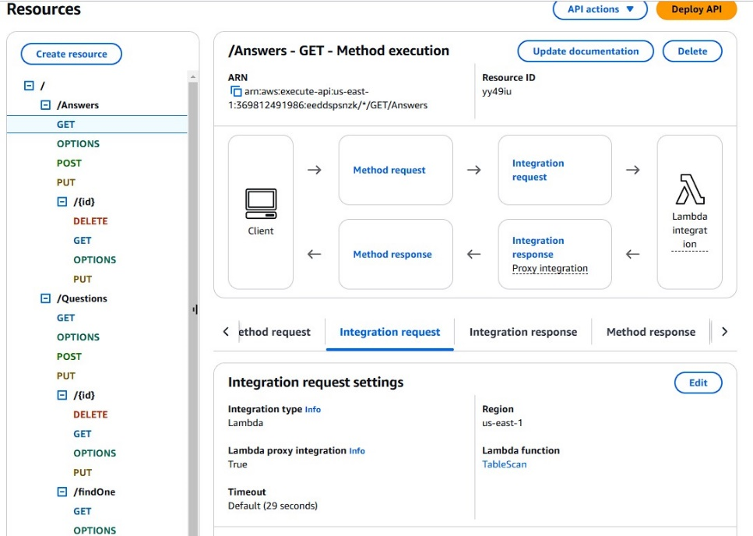
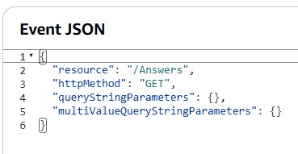
The Serverless Cloud
Database

Slide 9
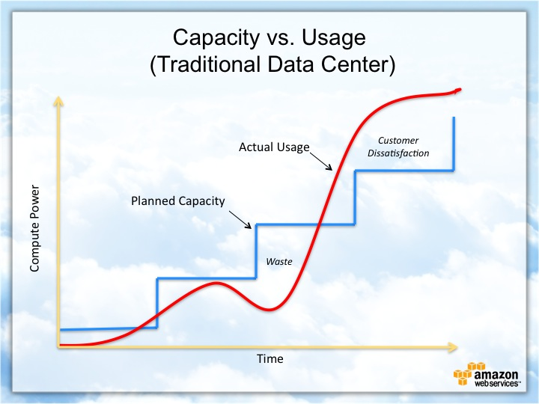
Cloud-Based Development Principles
Elasticity
AWS Cloud based models automatically scale up or down based on traffic. This creates an optimal performing application that is also cost-effective since it only uses resources when needed.
Pay-for-use model
Resources are only paid for when they are used, whether it is computing power, storage, traffic.
This helps to reduce resource waste, and cost for developers.

Slide 10
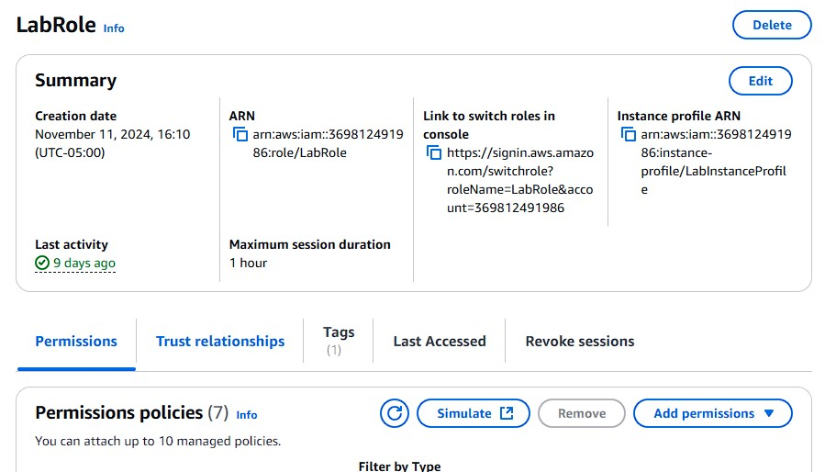
Securing Your Cloud App
Preventing Unauthorized Access
Use IAM roles: Created to assign specific permissions to certain team members. These provide temporary credentials.
Define policies written in JSON, that defines permissions for identities or specific resources.
Adhere to the principle of least privilege. This suggests for granting the bare minimum permissions to complete a task.

Slide 11
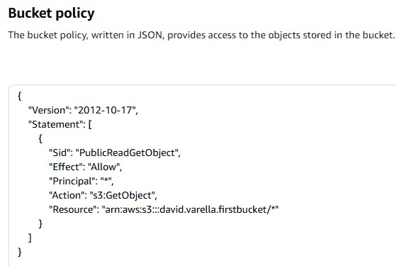
Securing Your Cloud App
Policies
What is the relationship between roles and policies?
IAM roles and policies work together to provide access to users and objects.
Policies are attached to IAM roles or other resources. A policy is an object that defines permissions of a resource.
When a role is given/used by a user or object, temporary credentials are issued, which determine the accessible permissions based on the policy.
A policy determines what a role is allowed to do
What custom policies were created?
A single bucket policy was created to enable read access to our S3 bucket

Slide 12
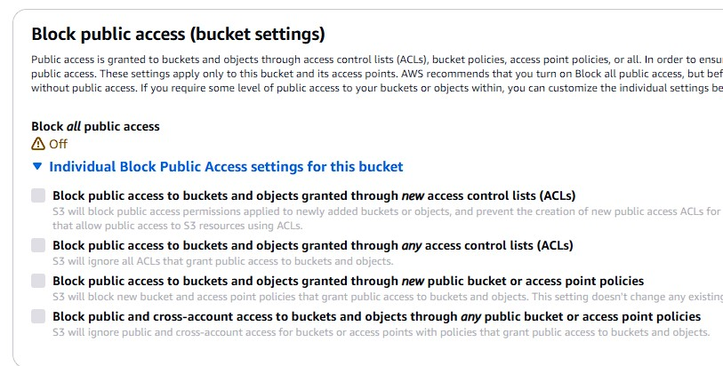
Securing Your Cloud App
API Security
How can you secure the connection to an S3 bucket?
Use correct policies
Limit public access(unless needed)
Use the principle of least privilege
Use IAM roles for applications that require S3 access
Server-side encryption
How can you secure the connection between Lambda and Gateway?
Set Cross-Origin Resource Sharing: Restricts how resources can be requested from external third parties. Prevents unauthorized access.
Use IAM roles and policies to create a Lambda function initiated by an API Gateway resource.
Authorization – allow users access based on least privilege.
How can you secure the connection between Lambda and the database?
Use IAM roles and policies, and authentication, with a database such as DynamoDB that integrates with IAM.
Encrypt communication.
Use a proxy to manage database connections.

Slide 13
Conclusion
Three Main Points
IAM Roles and Policies are essential for controlling resource access. Roles define who or what (user/services) can perform certain actions with AWS services, and policies help by defining the permissions that each IAM role contains. These tools prevent unauthorized access by working together.
Scaling and cost of cloud-based services: AWS S3 offers automatic scaling based on real-time traffic needs. This eliminates wasted resources and the possibility of not having enough. AWS S3 is also very cost efficient, not only because of the automatic scaling, but the pay-per-use model eliminates the need to predict storage needs and reduces waste. Also, the lack of a physical server reduces cost due to having less server maintenance and power costs.
Containerization with tools such as Docker and Docker Compose is a major component of cloud-based development. Packaging applications and dependencies into a “container”, which is an isolated environment, simplifies development by ensuring a consistent behavior across multiple systems in development, testing and deployment.
Thank you for your time.

Slide 14
Sources
https://www.jscape.com/blog/amazon-s3-vs-local-storage-where-should-you-store-files-uploaded-to-your-file-transfer-server
https://aws.amazon.com/s3/#:~:text=Amazon%20Simple%20Storage%20Service%20(Amazon,availability%2C%20security%2C%20and%20performance.
https://www.techtarget.com/searchcloudcomputing/tip/Top-benefits-and-disadvantages-of-serverless-computing
https://www.cloudflare.com/learning/serverless/why-use-serverless/#:~:text=Using%20a%20serverless%20infrastructure%2C%20there,and%20release%20a%20new%20product.
https://www.mongodb.com/resources/compare/mongodb-dynamodb
Thank you for your time.

